Slide 1
Subroutines and Control Abstraction
Ms.Seema Jadhav

Slide 2
Abstraction
Abstraction is the act of representing essential features without including the background details or explanations.
Abstraction: - abstraction as a process by which the programmer can associate a name with a potentially complicated program fragment, which can then be thought of in terms of its purpose or function, rather than in terms of its implementation.
Two types of abstraction:
1.Control abstraction -Control abstraction is association of a name with a program fragment that performs an operation, and is thought of its purpose or function, rather than its implementation
2.Data abstraction -purpose of the abstraction is to represent some information

Slide 3
Subroutines Introduction
Subroutines are the principal mechanism for control abstraction in most programming languages
Subprograms are the fundamental building blocks of programs and are therefore among the most important concepts in programming language design.
The reuse results in several different kinds of savings, including memory space and coding time.

Slide 4
A subroutine performs its operation on behalf of a caller , who waits for the subroutine to finish before continuing execution.
Most subroutines are parameterized: the caller passes arguments that influence the subroutine behaviour, or provide it with data on which to operate.
General Subroutines Characteristics
a. A subroutines has a single entry point.
b. The caller is suspended during execution of the called subroutines, which implies that there is only one subroutines in execution at any given time.
c. Control always returns to the caller when the called subroutines' execution terminates

Slide 5
A subprogram call is an explicit request that the called subprogram be executed.
A subprogram is said to be active if, after having been called, it has begun execution but has not yet completed that execution.
The two fundamental types of the subroutines are:
Procedures-A subroutine that does not return a value
Functions-A subroutine that returns a value
Most subroutines are parameterized & Arguments in the time of call are also called actual parameters. They are mapped to the subroutine’s formal parameters at the time a call occurs.

Slide 6
Most languages require subroutines to be declared before they are used, (including Fortran, C, and Lisp) do not.
Declarations allow the compiler to verify that every call to a subroutine is consistent with the declaration;
for example, that it passes the right number and types of arguments.
subroutines header is the first line of the definition, serves several definitions:
The following syntactic unit is a subroutines definition
The header provides a name for the subroutines.
May optionally specify a list of parameters

Slide 7
#include<stdio.h>
int add(int n1,int n2)
{
int s;
s=n1+n2;
return s;
}
void main()
{
int num1,num2,sum=0;
printf(“Enter two no’s:”);
scanf(%d%d,&num1,&num2);
sum=add(num1,num2);
printf(“\nsum=%d”,sum);
}

Slide 8
Enter two no’s
4
5
sum=9
add()
n1
4
n2
5
s
9
main()
num1
4
num2
5
sum=0
0

Slide 9
Subroutine header examples
Fortran
Subroutine Adder(parameters)
Ada
procedure Adder(parameters)
C
void Adder(parameters)
•Function declarations are common in C and C++ programs, where they are called prototypes.
•Java and C# do not need declarations of their methods, because there is no requirement that methods be defined before they are called in those languages.

Slide 10
The storage consumed by parameters and local variables can in most languages be allocated on a stack
The allocation of space on a subroutine call - stack
Each routine, as it is called, is given a new stack frame,or activation record, at the top of the stack.
This frame may contain arguments and/or return values, bookkeeping information (including the return address and saved registers), local variables, and/or temporaries.
When a subroutine returns, its frame is popped from the stack.
Stack layout for storage

Slide 11
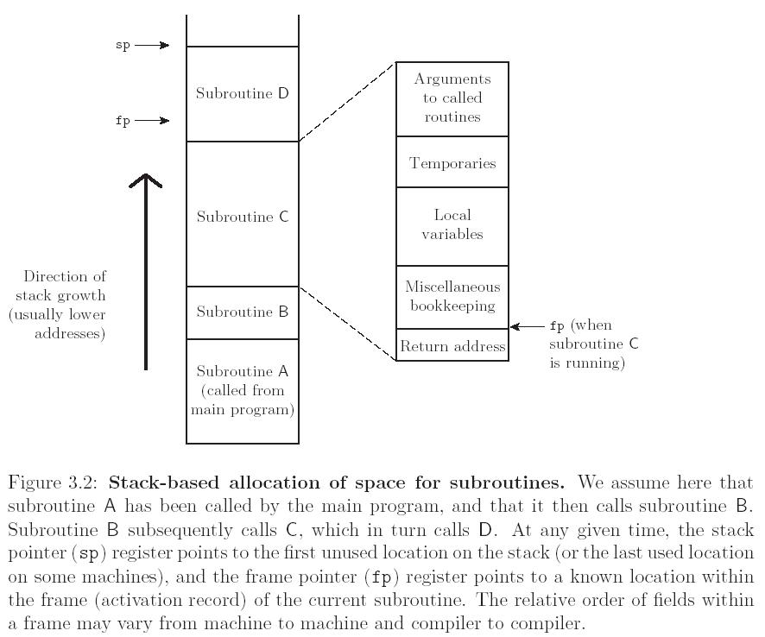
Stack layout for storage

Slide 12
Stack recap: Each routine, as called, gets a new frame put on the top of the stack contains arguments, return values, book-keeping info, local variables, and temporaries.
With stack allocation, the subroutine frame for the current frame is on top of the stack
sp: top of the stack
fp: an address within the top frame
To access non-local variables, static link (for static scoping) or dynamic link (dynamic scoping) are maintained in the frame
Stack layout for storage

Slide 13
Static and dynamic links maintained on stack:
Dynamic links allow one to walk back the frame pointer linearly down the call stack.
Static links allow one to walk back the frame pointer from a lexical viewpoint.
Stack layout for storage

Slide 14
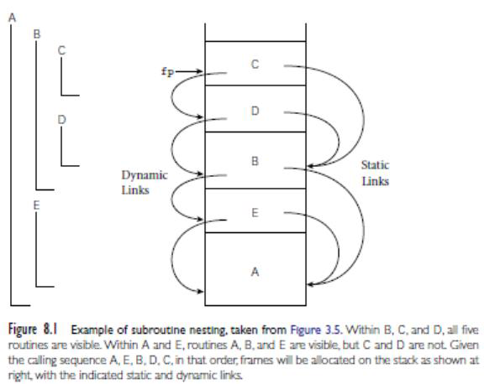

Slide 15
If subroutine D is called directly from B, then clearly B’s frame will already be on the stack .
It is not visible in A or E, because it is nested inside of B.
A moment’s thought makes clear that it is only when control enters B (placing B’s frame on the stack) that D comes into view.
It can therefore be called by C, or by any other routine (not shown) that is nested inside C or D, but only because these are also within B.

Slide 16
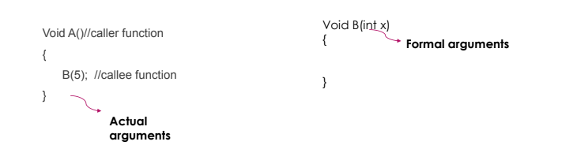
Calling Sequence
Let us assume that a function B() is called from another function A().
In this case A is called the “caller function” and B is called the “called function or
callee function”.
Also, the arguments which A sends to B are called actual
arguments and the parameters of B are called formal arguments.

Slide 17
Calling Sequence is maintaining the subroutine call stack
Calling sequences in general have three components
•The code executed by the caller immediately before and after a subroutine call.
•Prologue: code executed at the beginning of the subroutine
•Epilogue: code executed at the end of the subroutine
Calling Sequence

Slide 18
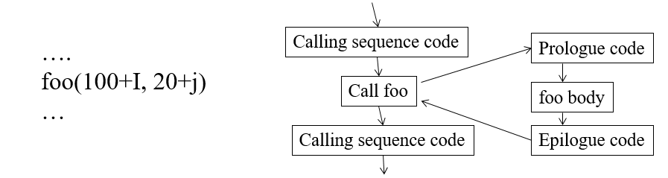
Example

Slide 19
The term ―calling sequence” is used to refer to the combined operations of the caller, the prologue , and the epilogue.
Maintenance of the subroutine call stack is the responsibility of the calling sequence
calling sequence refers to the code executed by the caller immediately before and after a subroutine call —and of the prologue (code executed at the beginning) and epilogue(code executed at the end) of the subroutine itself.

Slide 20
Thank You

